Slide 1
Title: Feature Extraction and Price Prediction for Mobile Phones
Subtitle: Machine Learning Approach to Mobile Price Prediction
Presented by: Manoj Kapri

Slide 2
Introduction
Objective: Predict mobile phone prices using machine learning.
Key Focus Areas:
  Data Cleaning & Processing
  Feature Selection & Extraction
  Model Training & Evaluation
  Insights & Recommendations

Slide 3
Dataset Overview
Dataset: Processed Flipdata.csv
Key Features:
  RAM, Battery Capacity, Processor, Camera Specs
  Screen Size, Brand, Internal Storage
  Price (Target Variable)
Data Shape: [Rows] x [Columns]

Slide 4
Data Preprocessing
Handling Missing Values: Replaced with mean for numerical data.
Categorical Encoding: One-Hot Encoding for categorical features.
Duplicate Removal: Ensured clean dataset for training.
Outlier Detection: Used IQR method to cap extreme values.

Slide 5

Feature Extraction & Selection
Correlation Analysis: Identified relationships between variables.
Feature Importance (Random Forest):
  RAM, Battery, Processor had highest impact on price.
Dimensionality Reduction: Removed irrelevant features.

Slide 6
Model Building
Algorithms Used:
Linear Regression (Baseline Model)
Decision Trees & Random Forest
Gradient Boosting (Advanced Model)
Train-Test Split: 80% Training | 20% Testing

Slide 7
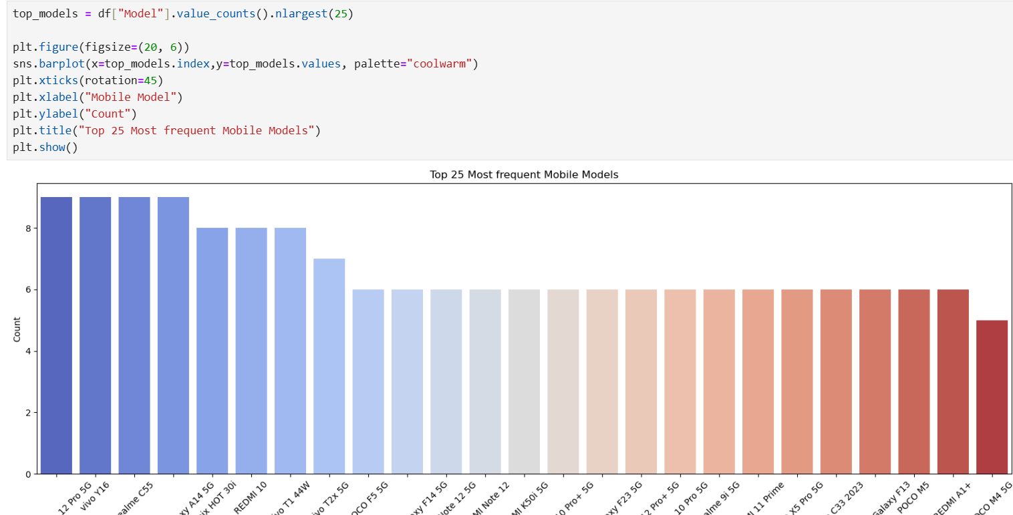

Slide 8
Model Evaluation
Metrics Used:
  Mean Absolute Error (MAE)
  Root Mean Squared Error (RMSE)
Results:
  MAE: 3574.11171
  RMSE: 7141.09177
Best Model: Random Forest (Higher Accuracy)

Slide 9
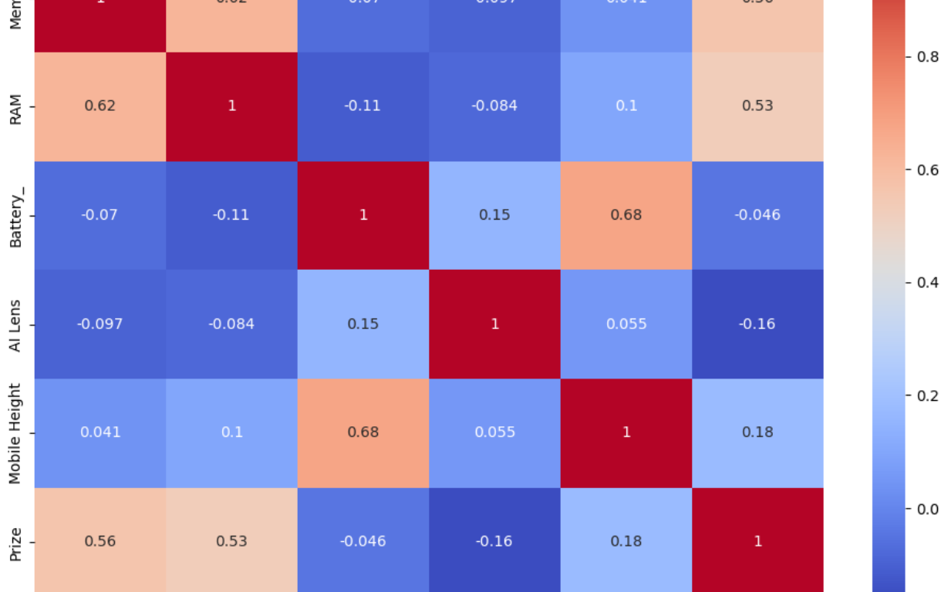

Slide 10
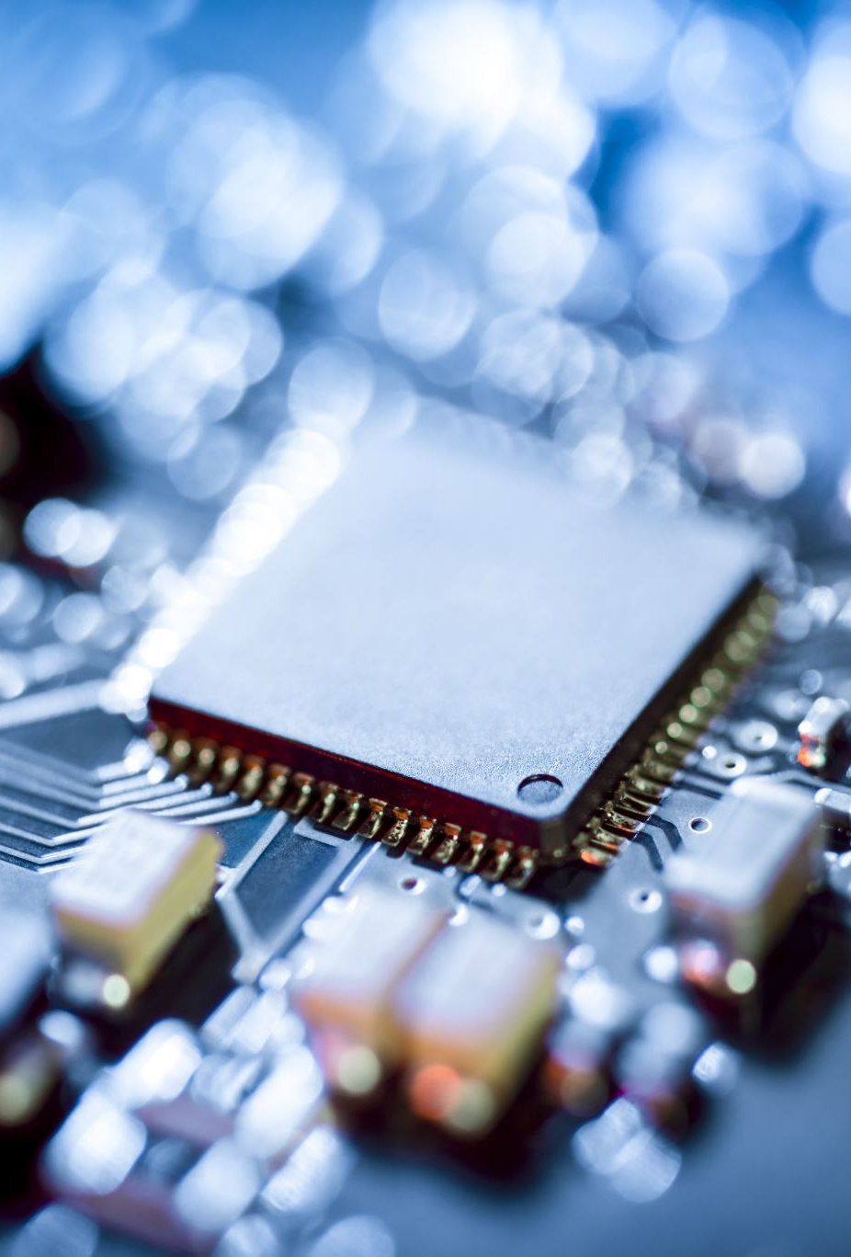
Insights & Recommendations
Most Important Features: RAM, Battery, Processor.
Price Optimization Strategies:
  Focus on high-demand features.
  Competitive pricing based on specifications.
Future Work:
  Improve accuracy using deep learning.
  Real-time price prediction model.

Slide 11
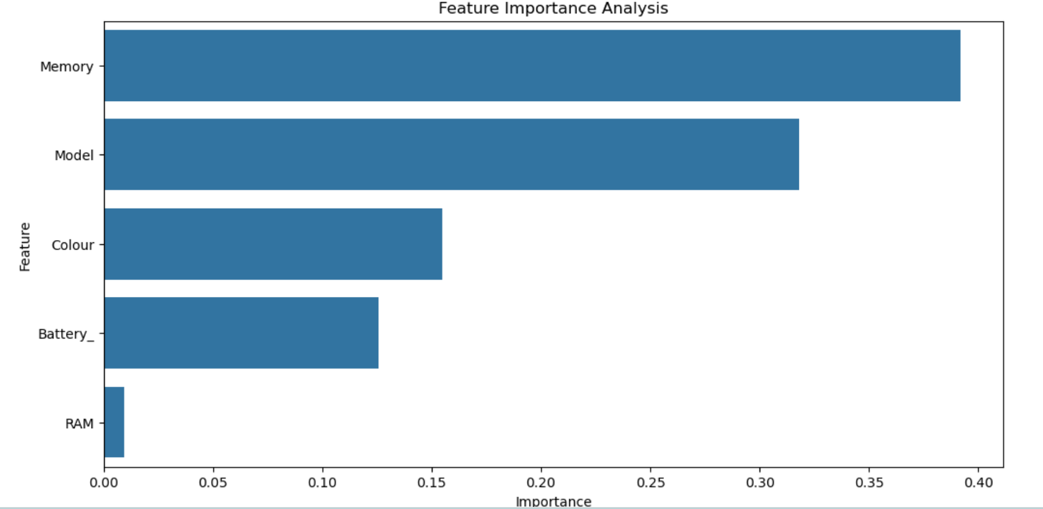

Slide 12

Conclusion
Successfully developed a price prediction model.
Provided data-driven insights for mobile pricing.
Future scope for further improvements.

Slide 13
Questions?
Contact: [kaprimanoj88@gmail.com]
Thank You!

